Slide 1
Big Data Processing
Jiaul Paik
Lecture 15

Slide 2
Plan
Important Spark Operations
Spark Programming: Examples
Simple Programming
Iterative Programming

Slide 3
Important Spark Operations

Slide 4
map vs flatmap
map(f):
Return a new distributed dataset formed by passing each element of the source through a function f
data.txt
-------------
I am here
She is there
You are here
flatMap(f):
Similar to map, but each input item can be mapped to 0 or more output items (so f should return a Sequence rather than a single item)
Example: Counting number of letters in each lines
Example: getting words from each line

Slide 5
reduceByKey vs groupByKey
reduceByKey(f):
Aggregates data based on the common keys
It is done in each partition, before they are shuffled
groupByKey:
Returns the set of elements with common key

Slide 6
reduceBykey: Illustration
Find sum of values based on the common keys
(a,1)
(a,1)
(b,2)
(a,1)
(a,2)
(b,2)
(a,3)
(b,1)
(a,1)
(a,1)
(b,2)
(b,1)
(b,2)
(b,1)
(a,2)
(b,2)
(a,6)
(b,3)
(a,2)
(b,6)
(a,2)
(a,6)
(a,2)
(b,2)
(b,3)
(b,6)
(a,10)
(b,11)

Slide 7
groupByKey: Illustration
Find sum of values based on the common keys
(a,1)
(a,1)
(b,2)
(a,1)
(a,2)
(b,2)
(a,3)
(b,1)
(a,1)
(a,1)
(b,2)
(b,1)
(b,2)
(b,1)
(a,1)
(a,1)
(a,1)
(a,2)
(a,3)
(a,1)
(a,1)
(b,2)
(b,2)
(b,1)
(b,2)
(b,1)
(b,2)
(b,1)
(a,10)
(b,11)

Slide 8
Problem: Word Count
You are given a text file containing a set of lines. Produce the words and its counts.
she is done
he will be okay
i can do it
my name is this
is,2
she,1
can, 1
.
.

Slide 9
Word Count: Spark Code
val data = sc.textFile("text.txt")
val words = data.flatMap(line => line.split("\\s+"))
val pair = words.map(w => (w,1))
val wordcount = pair.reduceByKey(_ + _)
wordcount.collect().foreach(println)
wordcount.saveAsTextFile("output")
// setting number of reduce tasks
val wordcount = pair.reduceByKey(_ + _, 4)

Slide 10
Problem: Finding average
Given a two column file with key (1st column) and value. Find the average value for each key.
sam 15
ram 25
abir 20
sam 30
ram 25
samir 30
kamal 30
abir 50
sam 22.5
ram 25
.
.
.

Slide 11
Finding average: Spark code
val data = sc.textFile("average.txt")
val pairs = data.map(line => {val s = line.split("\\s+")
(s(0), (s(1).toDouble,1))
}
)
val interout = pairs.reduceByKey{((t1,v1), (t2,v2)) => (t1+t2, v1+v2)}
val output = interout.map(r => (r._1, r._2._1/r._2._2))
output.saveAsTextFile(“outfile")

Slide 12
Problem: Join Two Tables
Given two tables T1 and T2 with m and n number of columns.
Join the tables based on the common column values.
Amar kgp 16
sandip kolkata 30
sundar delhi 35
T2
amar btech 1991
sandip mtech 2002
sundar msc 2016
T1
amar kgp 16 btech 1991
sandip kolkata 30 mtech 2002
sundar delhi 35 msc 2016

Slide 13
Table Join: spark Code
import breeze.linalg.{Vector, DenseVector, squaredDistance}
val tab1 = sc.textFile(“T1")
val tab1pair = tab1.map(line => {
val s = line.split("\\s+")
val len = s.length
var w = new Array[String](len-1)
for(i<-1 until len) {
w(i-1) = s(i)
}
(s(0), DenseVector(w))
}
)
val tab2 = sc.textFile(“T2")
val tab2pair = tab2.map(line => {
val s = line.split("\\s+")
val len = s.length
var w = new Array[String](len-1)
for(i<-1 until len) {
w(i-1) = s(i)
}
(s(0), DenseVector(w))
}
)
val joinedRdd = tab1pair.join(tab2pair)
joinedRdd.saveAsTextfile("output")

Slide 14
Problem: K-nearest neighbour search (KNN)
You are given n vectors $v_{1}, v_{2}, v_{3}, …, v_{n}$ of d-dimension (d columns). Given a query vector Q, find the
top k (say k=10) most similar vector to Q from the given set of vectors. The similarity is computed based
on cosine measure.
id
fields
Query vector
1 -0.135380 0.242444 0.114091 0.479621
0.026691 -0.406129 0.443043 0.881185
0.025691 -0.406129 0.443043 0.891185
15 -0.512065 3.641124 0.621640 -1.031282

Slide 15
KNN: Spark code
Read the vectors from file and convert it to key and value pairs
Key = vector id, value = vector fields
Read the query vectors
Compute the cosine similarity between the query vector and each of the given vectors
Find out the top k most similar vectors

Slide 16
KNN: Spark code
val doc = sc.textFile("knn-vec")
val procDocs = doc.map(line => {
var temp = line.split("\\s+")
var docid = temp(0)
var len = temp.length
var elements = new Array[Double](len-1)
for(i <- 1 to (len-1) ) {elements(i-1) = temp(i).toDouble}
(docid, elements)
}
).cache
val query = sc.textFile("knn-query")
val procQuery = query.map(line => {
var temp = line.split("\\s+")
var qid = temp(0).toInt
var len = temp.length
var elements = new Array[Double](len-1)
for(i <- 1 to (len-1) ) {elements(i-1) = temp(i).toDouble}
(qid, elements)
}
).cache

Slide 17
KNN: Spark Code
val allq = procQuery.collect
val numq = allq.length
for(j <- 0 to (numq-1)) {
var qno = allq(j)._1
var qvec = allq(j)._2
procDocs.map(t => {
var sc = 0.0
var l1 = 0.0
var l2 = 0.0
var dim = qvec.length
for(i <- 0 to (dim-1)) {
sc += qvec(i) * t._2(i)
l1 += qvec(i) * qvec(i)
l2 += t._2(i) * t._2(i)
}
if(l2 == 0.0)
l2 = 1000000.0
sc = sc/(Math.sqrt(l1) * Math.sqrt(l2))
(sc, qno, t._1)
}
).top(10).foreach(println)
}
val doc = sc.textFile("knn-vec")
val procDocs = doc.map(line => {
var temp = line.split("\\s+")
var docid = temp(0)
var len = temp.length
var elements = new Array[Double](len-1)
for(i <- 1 to (len-1) ) {elements(i-1) = temp(i).toDouble}
(docid, elements)
}
).cache
val query = sc.textFile("knn-query")
val procQuery = query.map(line => {
var temp = line.split("\\s+")
var qid = temp(0).toInt
var len = temp.length
var elements = new Array[Double](len-1)
for(i <- 1 to (len-1) ) {elements(i-1) = temp(i).toDouble}
(qid, elements)
}
).cache

Slide 18
Clustering
Given a set of n objects (as vectors of dimension d), cluster them into k groups so that
the objects in each group are similar to each other
the objects in different groups are dissimilar to each other

Slide 19
K-means
Main steps of k-means:
STEP 1: Start with k initial cluster centers
STEP 2: Assign/cluster each member to the closest center
go back here
Iterative steps
STEP 3: Recalculate centers as the mean of the points in a cluster

Slide 20
K-means: Spark Code
//reading and parsing data
val lines = sc.textFile(“filename”)
val data = lines.map(parseVector ).cache()

Slide 21
K-means: Spark Code
//reading and parsing data
val lines = sc.textFile(“filename”)
val data = lines.map(parseVector ).cache()
//set number of cluster
val K = numClust

Slide 22
K-means: Spark Code
//reading and parsing data
val lines = sc.textFile(“filename”)
val data = lines.map(parseVector ).cache()
//set number of cluster
val K = numClust
//initialize centroids
val kCenters = data.takeSample(withReplacement = false, K, 5)
// iterative steps
while(i < maxIter) {
val closest = data.map (p => (getClosestCenter(p, kCenters), (p, 1)))
val pointStats = closest.reduceByKey(mergeResults)
val newkCenters = pointStats.map {pair =>
(pair._1, pair._2._1 * (1.0 / pair._2._2))}.collectAsMap()
for (j <- newkCenters) {
kCenters(j._1) = j._2
}
}
kCenters.foreach(println)
RDD to dictionary
getClosestCenter(p, centers) -> id of the closest centroid
mergeResults -> (centroid id, (sum of points in the cluster, no of points in the cluster))

Slide 23
Pagerank Analysing the Link Structure of the Web

Slide 24
Introduction
Why is Page Importance Rating important?
New challenges for information retrieval on the World Wide Web.
Huge number of web pages:
Diversity of web pages: different topics, different quality, etc.
What is PageRank?
A method for rating the importance of web pages
It uses the link structure of the web.

Slide 25
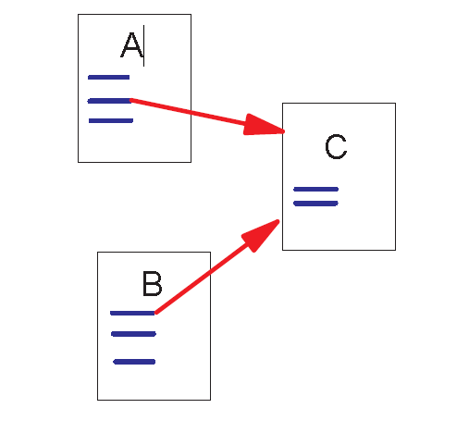
Link Structure of the Web
Backlinks and Forward links
A and B are C’s backlinks
C is A and B’s forward link
Intuitively, a webpage is important if
It has a lot of backlinks.
Importance of the page giving the backlink
what if the link is from www.google.com?

Slide 26
A Simple Version of PageRank
backlink
$$R\left(u\right)=c \sum_{v∈B_{u}}{\frac{R\left(v\right)}{N_{v}}}$$
u
backlink
u: a web page
B_{u}: the set of u’s backlinks
N_{v}: the number of forward links of page v
c: the normalization factor

Slide 27
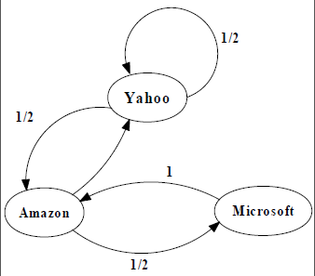
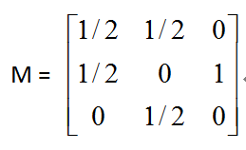
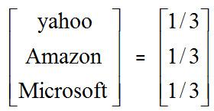
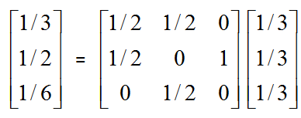
An example of Simplified PageRank
1/2
PageRank Calculation: first iteration

Slide 28
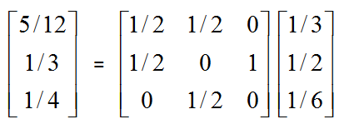
An example of Simplified PageRank
PageRank Calculation: second iteration

Slide 29
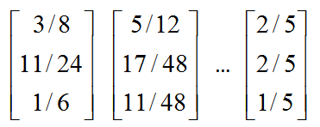
An example of Simplified PageRank
Convergence after some iterations

Slide 30
A Problem with Simplified PageRank: Loop issue
During each iteration, the loop accumulates rank but does not distributes the rank to other pages!

Slide 31
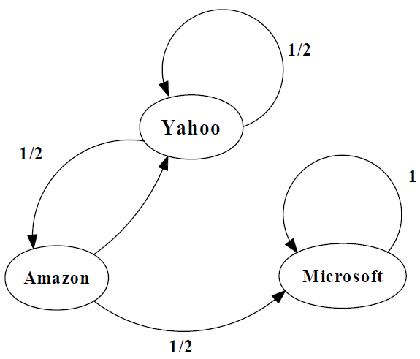
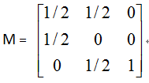
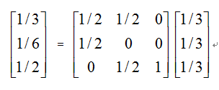
An example of the Problem

Slide 32
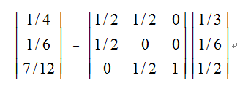
An example of the Problem

Slide 33
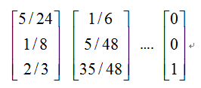
An example of the Problem

Slide 34
Random Walks in Graphs
The Random Surfer Model
Simply keeps clicking successive links at random
The Modified Model
The “random surfer” simply keeps clicking successive links at random
But periodically “gets bored”
And jumps to a random page based on the distribution of E

Slide 35
Modified Version of PageRank
$$R\left(u\right)=c_{1} \sum_{v∈B_{u}}{\frac{R\left(u\right)}{N_{v}} +c_{2} E\left(u\right)}$$
a distribution of ranks of web pages that “users” jump to when they “gets bored” after successive links at random.

Slide 36

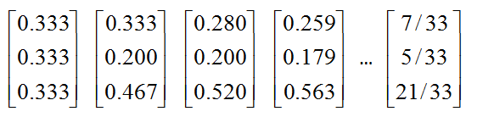
An example of Modified PageRank

Slide 37
PageRank in Spark

Slide 38
Pagerank in Spark: Steps
Part 1: Reading and storing data
Part 2: Populating the Initial pagerank values
Part 3: Looping
Calculating Contributions from individual pages
Re-calculating Ranks by aggregation

Slide 39
Data Format
From
page page
To
A B
B C
A D
D E

Slide 40
Reading and Storing data
// read file disk
val lines = sc.textFile(inputFile)
// create paired rdd (from node and to node)
val pairs = lines.map { s =>
val parts = s.split("\\s+")
(parts(0), parts(1))
}
// create adjacency list and store in memory
val links = pairs.distinct().groupByKey().cache()

Slide 41
Initialize the pagerank score
// set pagerank values to 1.0 for all pages
var ranks = links.mapValues(v => 1.0)

Slide 42
Looping to re-calculate pagerank scores
for (i <- 1 to numIters) {
val joinedRDD = links.join(ranks)
val adjRankRDD = joinedRDD.values
// normalize
val indNormScore = adjRankRDD.flatMap{ case (urls, rank) =>
val size = url.size
urls.map(urls => (url, rank / size)) // the ranks are normalized
}
ranks = indNormScore.reduceByKey(_ + _).mapValues((1-p) + p * _) // ranks RDD
}

Slide 43
Pagerank in Spark: How it works
ranks
joinedRDD
adjRankRDD
indNormScore
ranks
4 | 1
3 | 1
2 | 1
1 | 1
4 | (3,1), 1
3 | (2,1), 1
2 | 1,1
1 | 4,1
(3,1), 1
(2,1), 1
1,1
4,1
3 | 0.5
1 | 0.5
1 | 1.0
2 | 0.5
1 | 0.5
4 | 1.0
values
flatmap
3 | 0.5
1 | 2.0
2 | 0.5
4 | 1.0
4 | 1.0
3 | 0.57
2 | 0.57
1 | 1.85
join
mapValues
itr
1
reduceByKey
links
4 | (3,1)
3 | (2,1)
2 | 1
1 | 4
for (i <- 1 to numIters) {
val joinedRDD = links.join(ranks)
val adjRankRDD = joinedRDD.values
// normalize
val indNormScore = adjRankRDD.flatMap{ case (urls, rank) =>
val size = url.size
urls.map(urls => (url, rank / size))
}
// final ranks
val ranks = indNormScore.reduceByKey(_ + _).mapValues((1-p) + p * _)
}
join
4 | (3,1), 1
3 | (2,1), 0.57
2 | 1,0.57
1 | 4,1.85
itr
2
……

Slide 44
Thank you!

